Slide 1
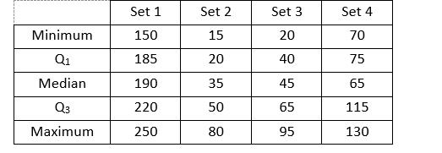
1. IQR
Which set of data has the smallest Interquartile Range?

Slide 2
2. Mean, Median, Mode, Range
Seven people were asked how many miles they lived from work. The responses were:
15, 7, 14, 21, 5, 9 and 13
Find the following:
A. Mean:
B. Median:
C. Mode:
D. Range:

Slide 3
3. Biased/Unbiased
Under the following examples, circle whether the survey sample is biased or unbiased. Explain your selection.
A. Question to answer:
What is your favorite sport?
Sample is chosen from people attending a soccer game.
BIASED or UNBIASED
B. Question to answer:
What is your favorite soft drink?
Sample is chosen by picking names out of a telephone book.
BIASED or UNBIASED
C. Question to answer:
Should more money be put into athletic programs or music programs at
school?
Sample is chosen from students in the band program.
BIASED or UNBIASED

Slide 4
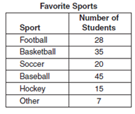
4. Making Predictions
Use the sample survey to make predictions.
If you randomly select a person, what is the probability that his or her favorite sport is basketball?
In a group of 200 people, how many do you predict would choose baseball as their favorite sport?
In a class of 45 students, how many students do you predict would choose soccer as their favorite sport?
In a group of 100 people, how many do you predict would choose hockey as their favorite sport?
Based on a sample survey, a local newspaper states that 75% of all the city’s voters turned out for the city council elections. If you randomly selected 200 people in that city, how many do you predict would have voted in the election?
F. What is the size of the sample for the above table?_________________________

Slide 5
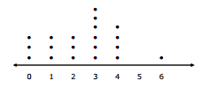
5. Dot Plots
Find the median.
Find the mean.

Slide 6
6. Box and Whisker Plot
A. What is the Inner Quartile Range?
B. Minimum?
C. Maximum?
D. What is the range of the top 25%?

Slide 7
Key
Set 3
A. 12, B. 13, C. No mode, D. 16
A. Biased, asked at SOCCER game, B. Unbiased, random, C. Biased, convenience
A. 7/30, B. 60, C. 6, D. 10, E. 150, F. 150
A. 3, B. 2.45
A. 4, B. 2, C. 9, D. 1

